Slide 1
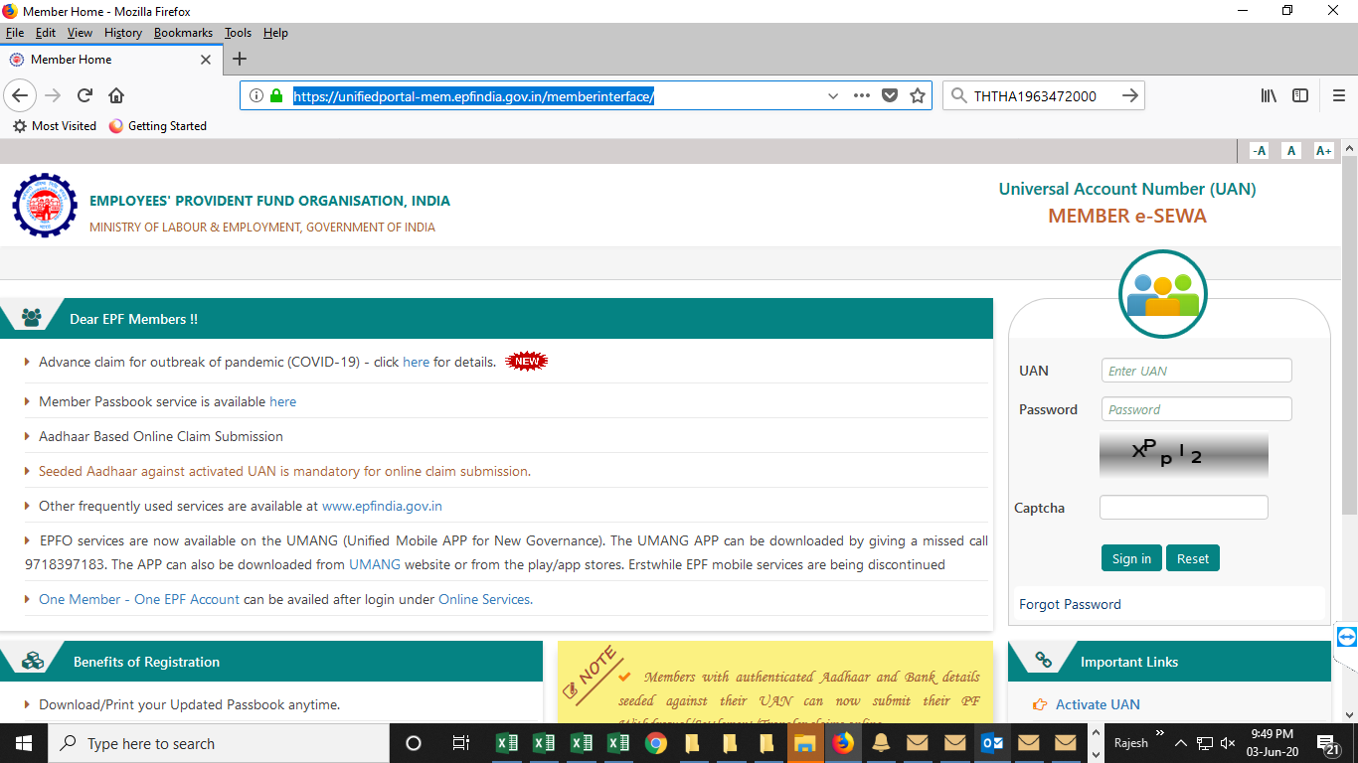
E-Nomination Process
Provident Fund Department has introduced the online e-nomination facility, all the PF account holders, it is important to
nominate someone in your family so that in case of death the nominee can easily claim the money. The e-nomination facility
can be used by those PF account holders whose Aadhaar is linked to their PF account
First of all login on UAN member portal through below link:-
https://unifiedportal-mem.epfindia.gov.in/memberinterface/

Slide 2
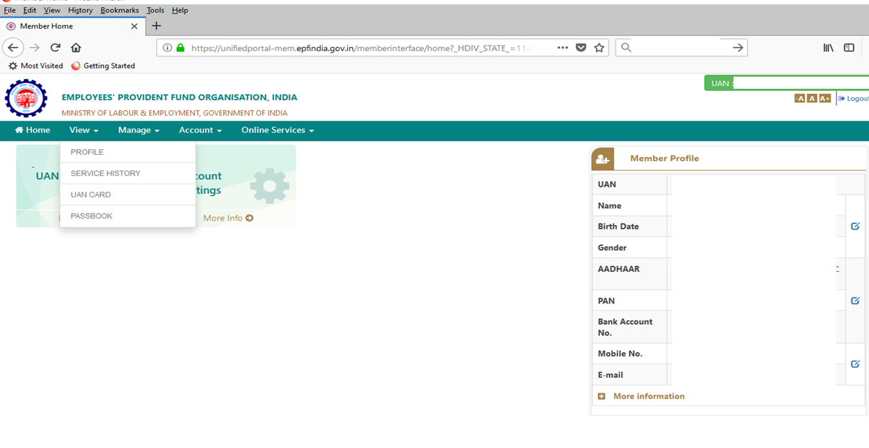
After logged in select the view option from menu bar and then click on profile

Slide 3
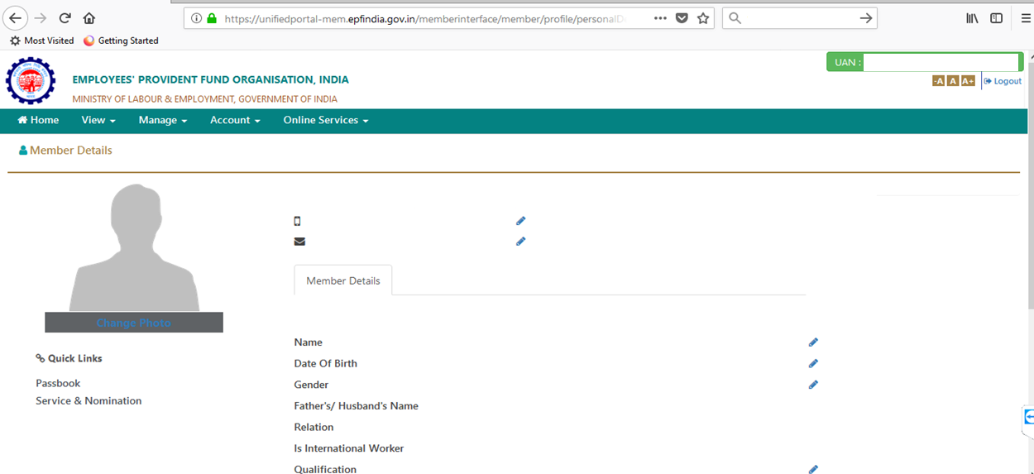
Under profile tab you may upload your profile photo.

Slide 4
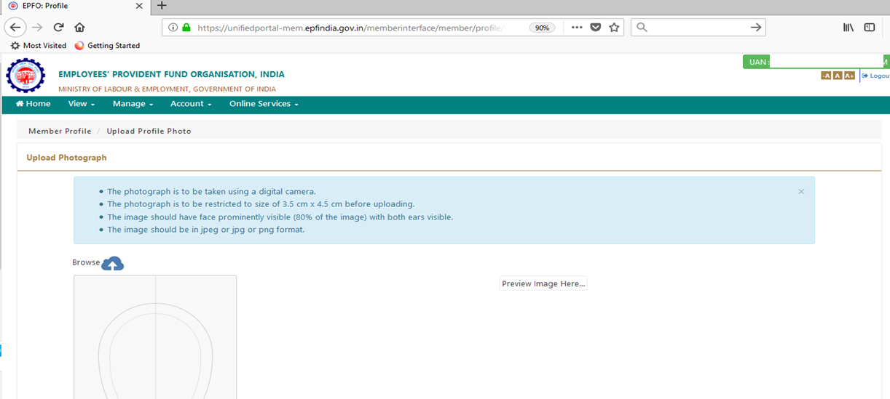
Before uploading the profile photo, fulfill the below requirements related to photo dimension/size.
Once you ready to upload, click on Browse link and select your photo from respective path/directory

Slide 5
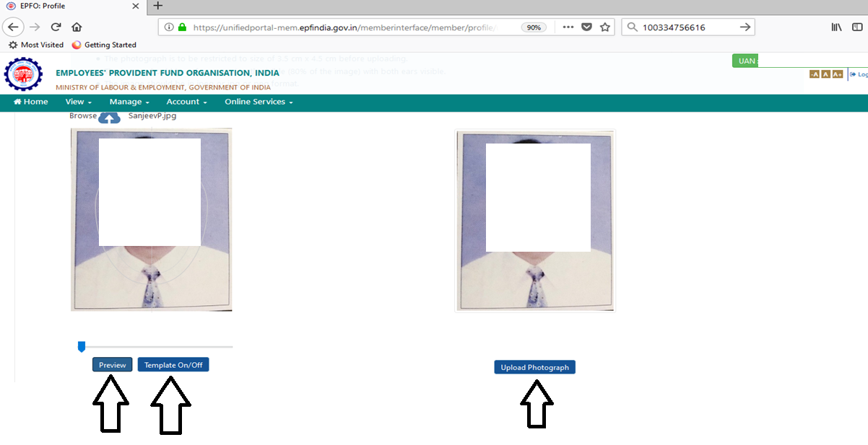
Once the photo is visible in the given box then you can adjust the same by scroll button given below the photo space then click on template ON/OFF button. After that photo will visible in next tab then click on upload photograph button

Slide 6
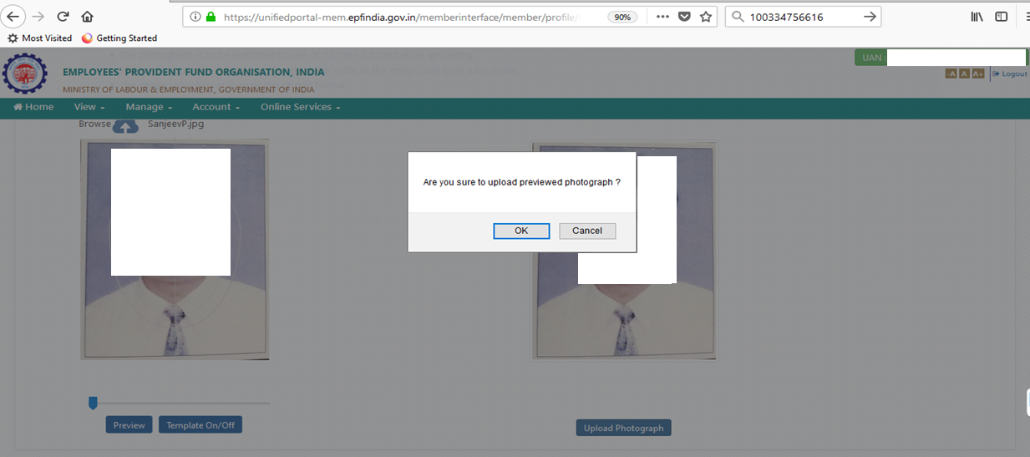
After clicking on Upload Photograph button the system will show the below message. Click on OK

Slide 7
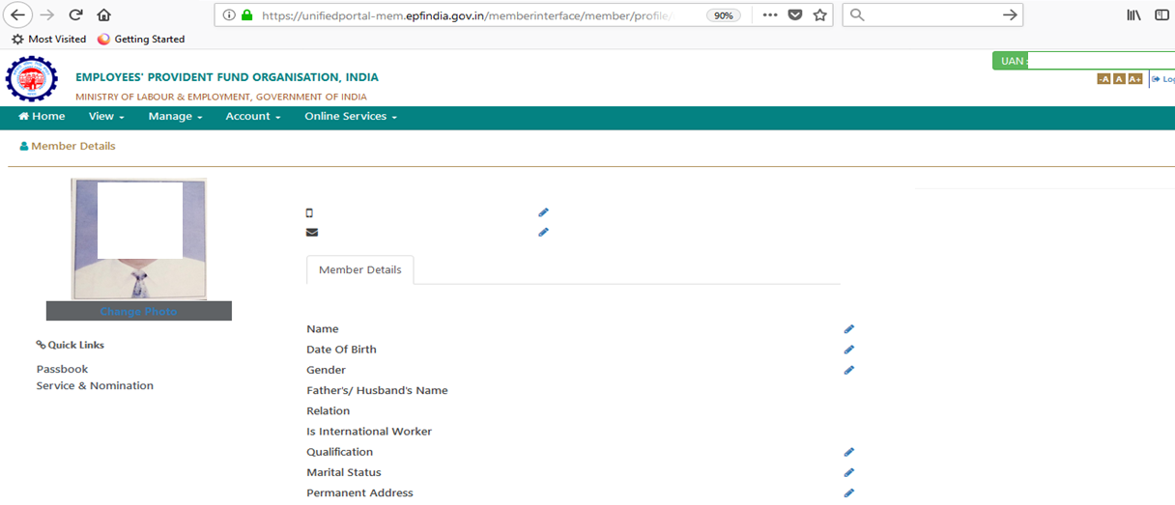
Now the profile photo is added.
However before updating the eNomiation detail. Ensure that all the given detail updated properly (i.e. DOB, Gender, Father/Husband Name, relation, marital status, Permanent and present address)

Slide 8
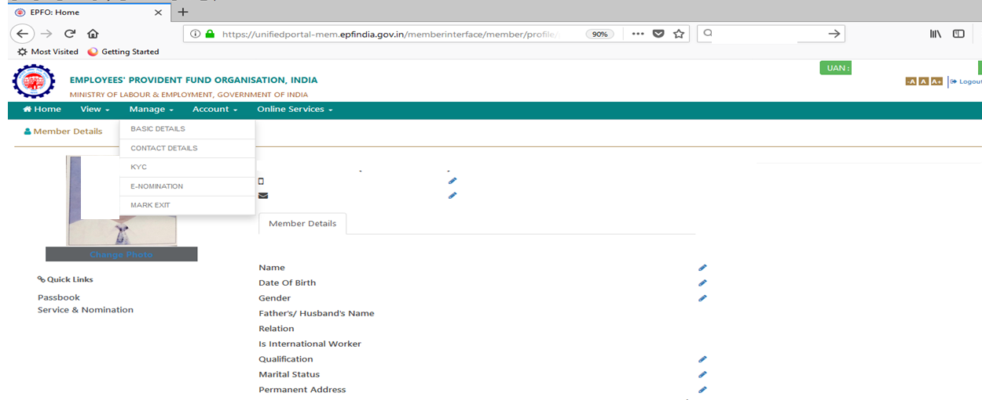
If all the detail and profile photo is updated then click on Manage option from menu bar and then select the E-Nomiation

Slide 9
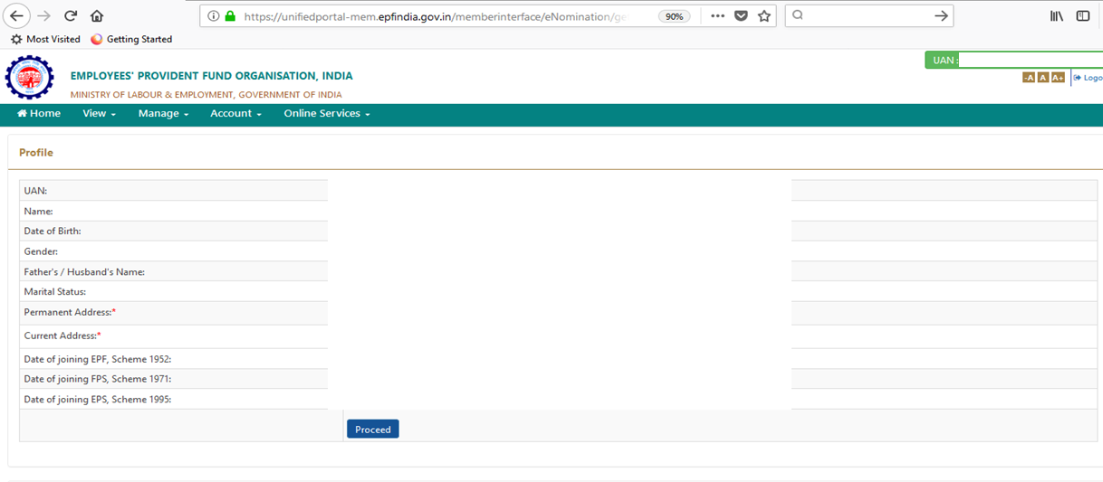
EPFO system will show you that profile detail. If everything is in line then you may proceed further

Slide 10
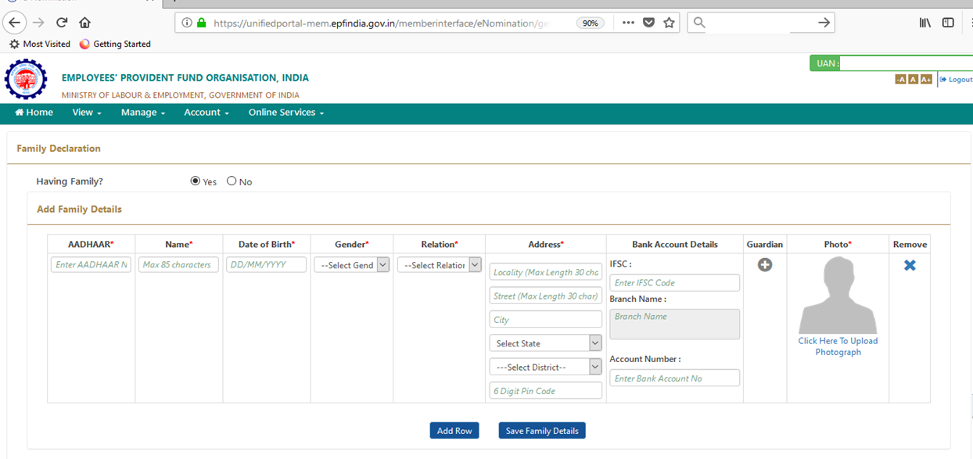
Selection the Family Declaration as per the given option and then upload the nominee’s photograph in the given space. Then filled all the given details as all are mandatory.

Slide 11
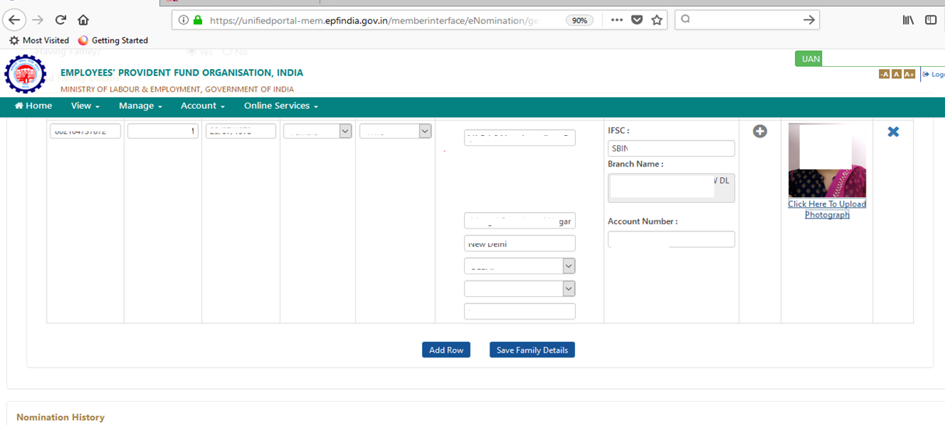
Once filled all the detail and upload the photograph of nominee then click on Save Family Detail button

Slide 12
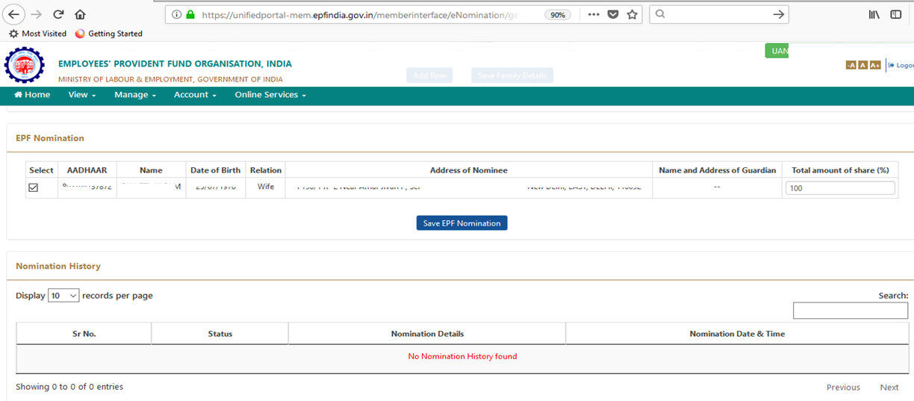
Then system will show the below detail. If detail is correct then you may click on Save EPF Nomination button.
If the nominee is other than spouse then you will have to fill the nominee detail under EPS section same as EPF

Slide 13
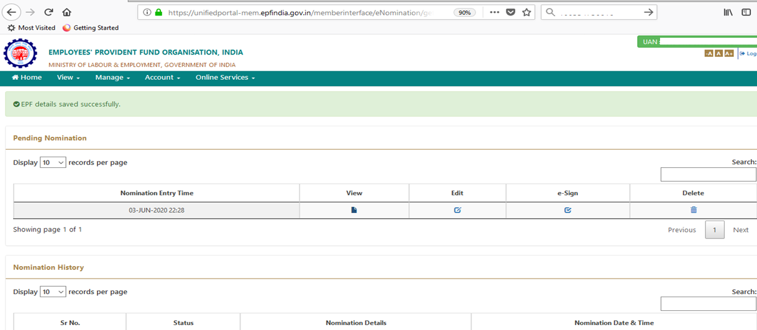
After that system will show you the below screen. Click on e-Sign option from below screen

Slide 14
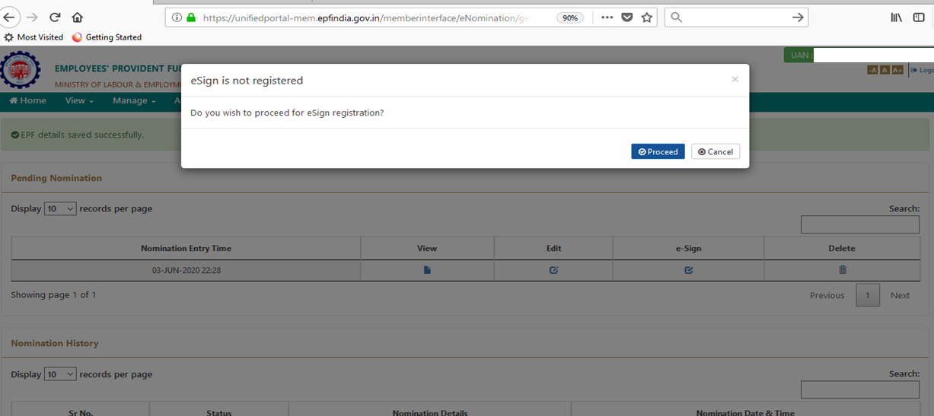
Click on Proceed button

Slide 15
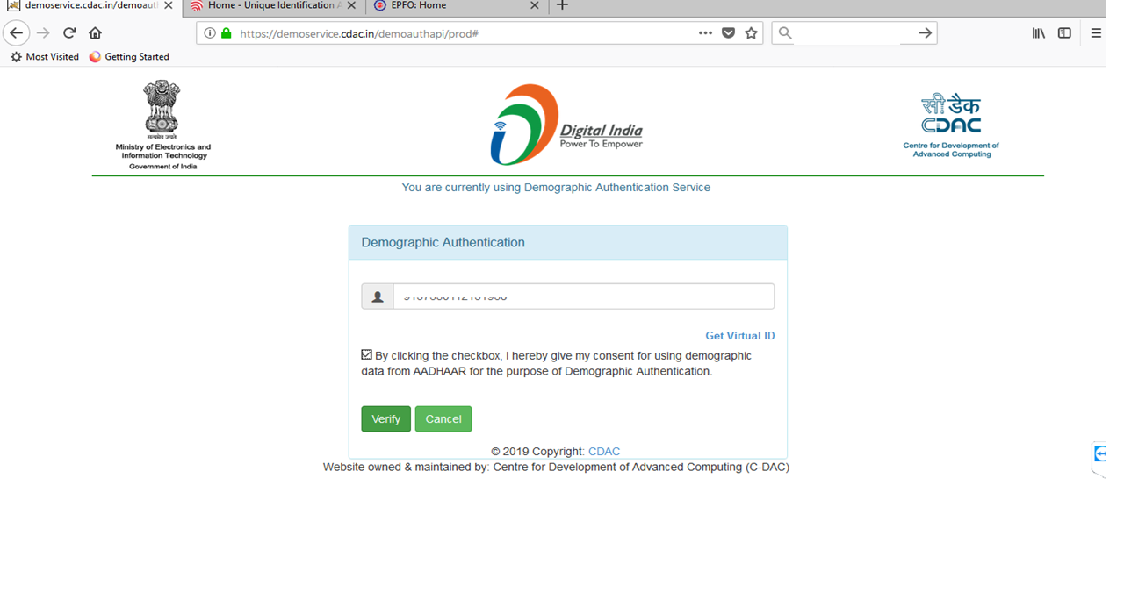
Open the previous page and fill the Virtual ID which you have received. Then click on the check box of consent and then click on Verify button

Slide 16
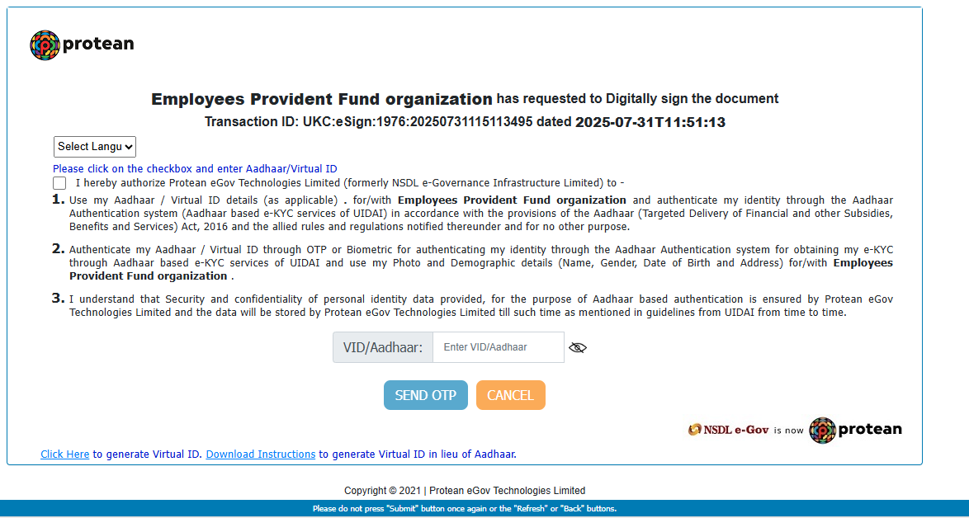
Click on the below check box of consent for using e-KYC service

Slide 17
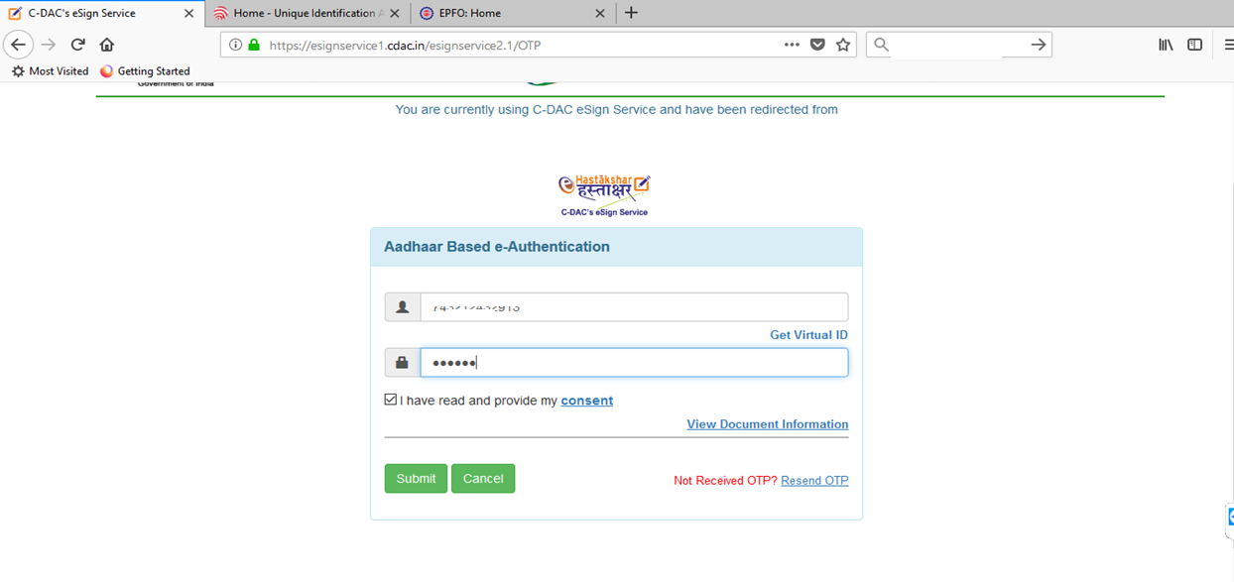
In the below fields fill the Virtual ID/Aadhaar number then click on Get OTP . You will get an OTP from UIDAI.
Once you submitted the OTP then process of eNomination will completed

Slide 18
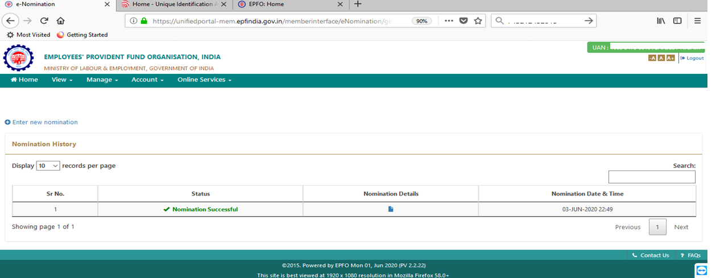
Now the process of E-Nomination has been completed. You may download the e-Nomination(form2) from below link for your
future reference.

